Slide 1
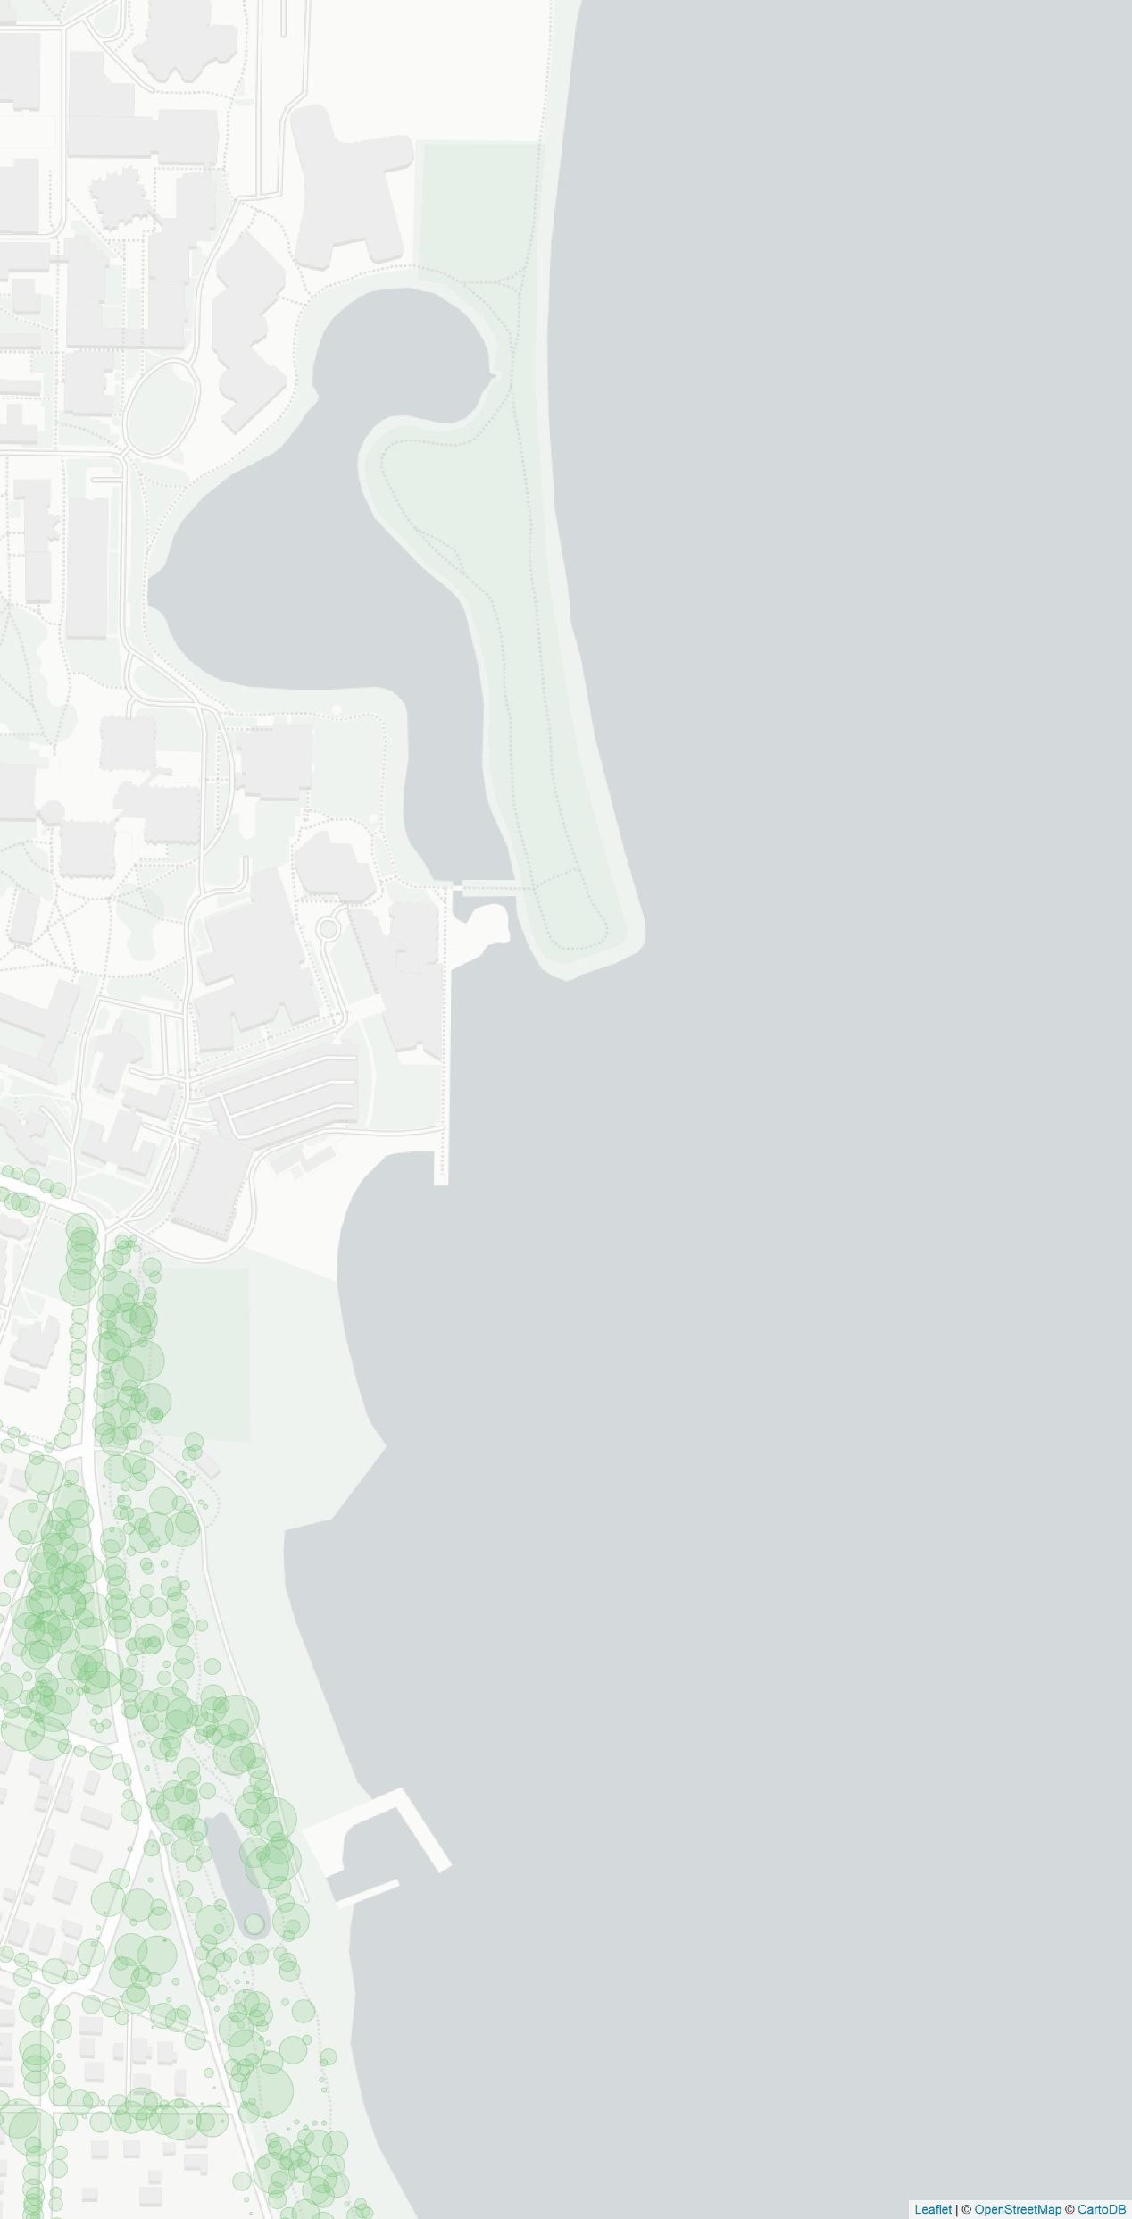
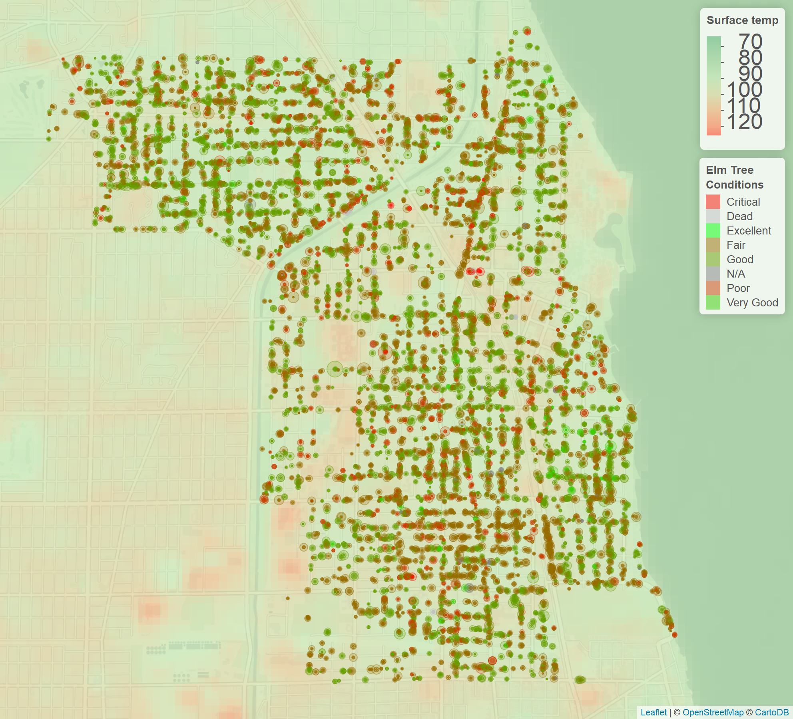
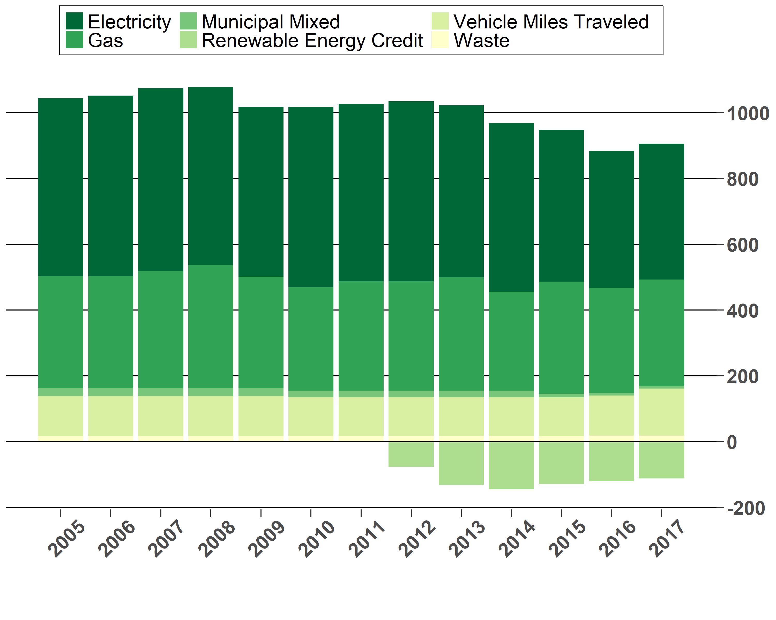
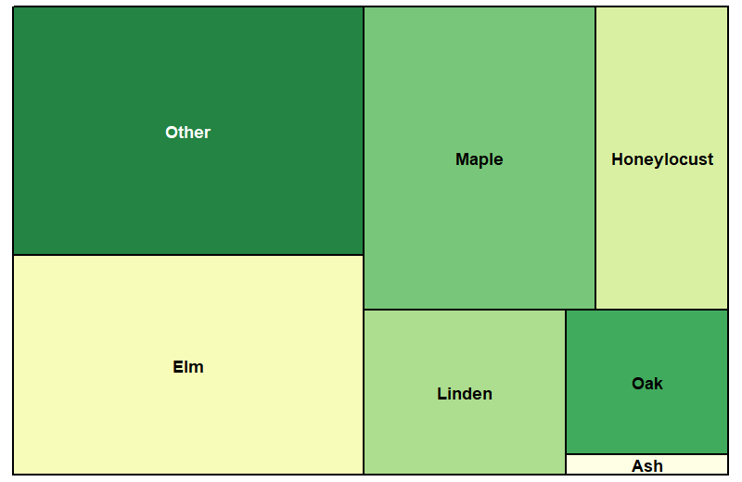
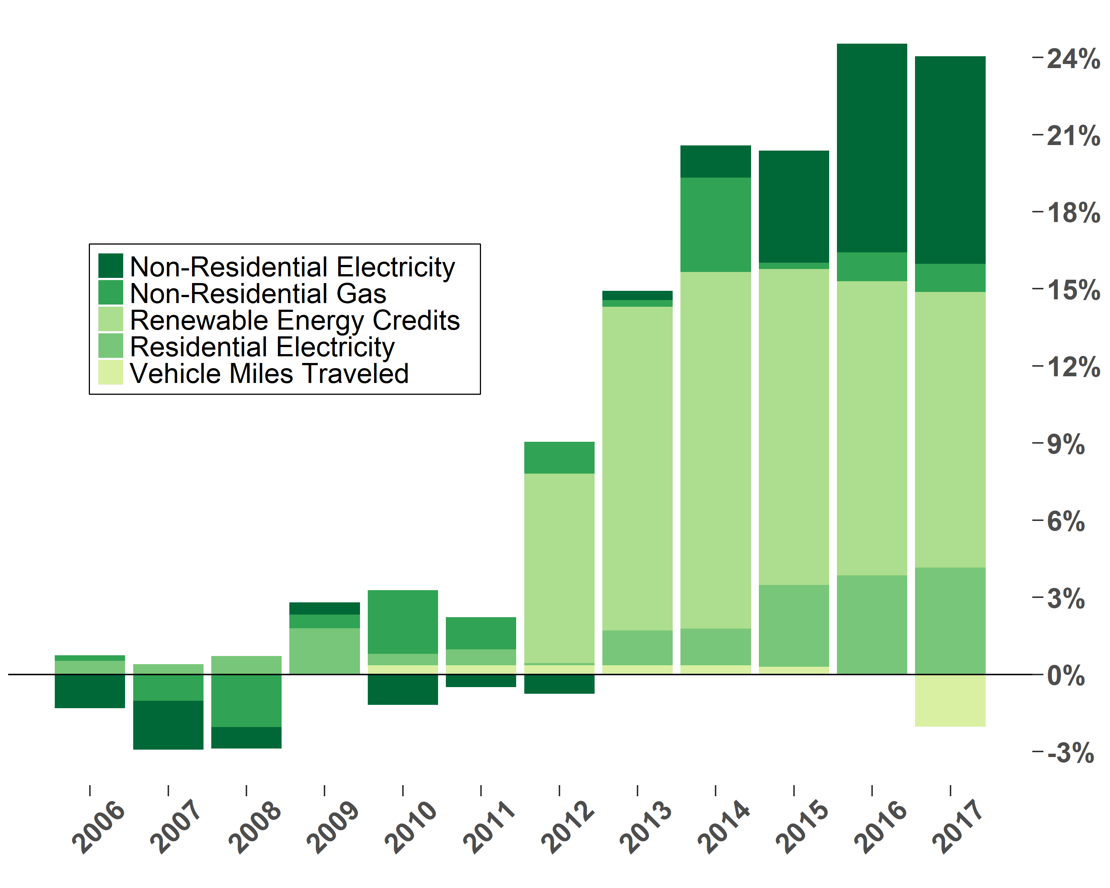

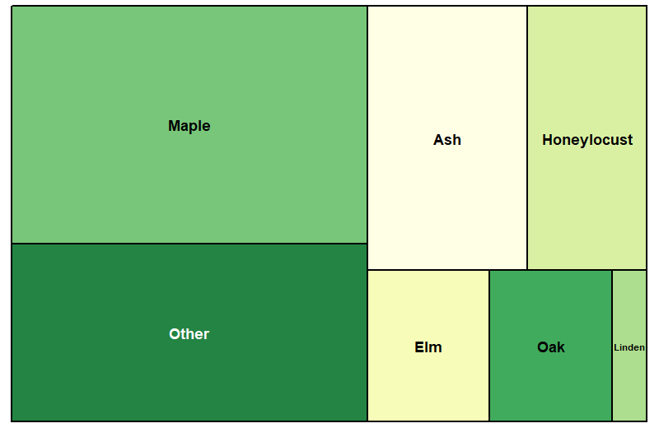
Miss the Forest for the Trees: Trees in Evanston’s Climate Action Resilience Plan (CARP)
Visualization by Caitlin Casar, Matthew Kirschner, and Jordan Nelson
Cutting greenhouse gas (GHG) emissions does not include the potential role of trees
One of the CARP goals is to eliminate GHG Emissions by 2050. Although there has been incremental reduction (Fig. 1), the majority of this is through increased Renewable Energy Credits (RECs) (Fig. 2). The cost-to-impact of RECs has diminishing returns as the grid becomes cleaner (source: Evanston CARP).
The Need For Trees
While Evanston already is planning on planting 2,000 trees, there are compelling reasons to plant even more!
Preparing for extreme heat events and flooding
Evanston’s tree canopy can intercept stormwater and provide valuable shade—its cooling effects can be seen from space (Fig. 3), reducing building energy use, the primary source of GHG emissions in Evanston (source: CARP).
Vulnerability of Elm trees
While Evanston already has over 34,000 trees, it is uniquely reliant on Elm trees (Fig 3, 4) which are currently at risk of Dutch Elm Disease.
Potential for REC investment
Renewable Energy Credits (RECs) could be spent locally on planting new trees, an investment that literally grows with time: this action can be certified or tokenized to sequester carbon, intercept stormwater, improve air quality, and decrease building energy use with shade.
How can you help?
Search “I Heart
Evanston Trees” for
ways to donate, or
scan this QR to contr-
ibute with Amazon
Smile. Thanks!
How was this made?
We used Python Pandas library for data cleaning and R for data visualization; GIS figures were made with Leaflet for R; basemap assets from CartoDB. Poster printing was sponsored by NU EPS Dept.
70°C
80°C
90°C
100°C
110°C
120°C
Sources of GHG Emissions
Thousands of Metric Ton Equivalents of CO₂
Year
Figure 3. Surface temperature from Sept 2016 land satellite data (source: USGS) overlaid on subset of genus Ulmus (Elm) from Evanston’s tree inventory (source: Evanston Open Data Portal). Each tree’s diameter-at-breast-height (DBH) is encoded to the size of its circle marker (not to scale with the map). The color of each elm tree is encoded to its condition as reported in the tree inventory. Many elms are dying of Dutch Elm Disease.
Figure 1. Sources of GHG Emissions per year in Evanston. ‘Municipal Mixed’ includes both electricity and gas sources; ‘Waste’ is from community garbage; ‘Electricity’ includes government non-city-owned buildings and CTA rail. Source: Evanston Open Data Portal
Top 5 Reductions in GHG Emissions
Figure 4 (left). Treemap of the portion of canopy contributed by common-name genus in the urban forest of Evanston (top, source: Evanston Data Portal) and the Chicago Region (bottom, source: 2014, Chicago Regional Tree Initiative and USDA Forest Preserve). The size of each tile is generated by summing the diameter-at-breast-height (directly correlated with canopy size) of each common-name genus.
Percent Reduction in GHG Emissions
Evanston
Tree Canopy by Common Genus
Year
Scan me
Figure 2. Top 5 use-categories and sources of reductions in GHG emissions per year in Evanston since 2005. Renewable energy credits do not include those purchased by Northwestern or NorthShore University Health System. Source: Evanston Open Data Portal
Chicago Region
45 in. = DBH
Figure 5. The background of this poster visualizes Evanston’s tree inventory near the shore of NU. Note that Northwestern’s forest is not included in this inventory. Each tree’s diameter-at-breast-height (DBH) is encoded to the size of its circle marker (not to scale with the map). Source: Evanston Open Data Portal

